Slide 1
Adoption of the Gestational
Diabetes Management System (GDm-health)
Ms Tracey Marriott, Director of Innovation Adoption,
BA Hons, Dip, MBA
Oxford Academic Health Science Network
Dr Lucy Mackillop, Consultant Obstetric Physician
Honorary Senior Clinical Lecturer
Oxford University Hospitals NHS Trust

Slide 2
What is Gestational Diabetes?
Carbohydrate intolerance resulting in hyperglycaemia of variable severity with onset or first recognition during pregnancy
Complications
Maternal & Fetal
Neonatal
Long-term effect:
Long-term risks of Type 2 Diabetes
and Obesity

Slide 3



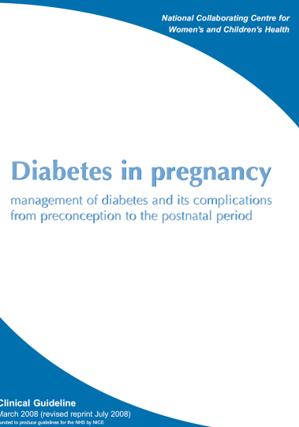


The motivation for GDm-health
NICE guidelines 2008
Increased screening
Increasing Obesity and Maternal Age
Change in
diagnostic criteria

Slide 4
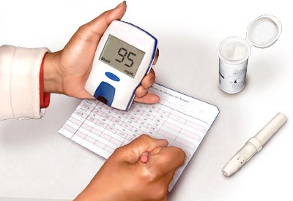

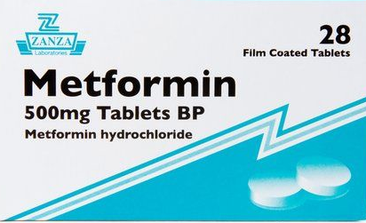

Management of Gestational Diabetes
At home:
1. Self-monitoring (BG) 2. Controlled diet 3. Metformin and/or insulin (6 times daily)
In clinic:
Blood glucose review (every 2-4 weeks)
Dietary advice and medication adjustments
Challenge
Treatment is difficult to predict
Demanding for patient
and for the NHS

Slide 5
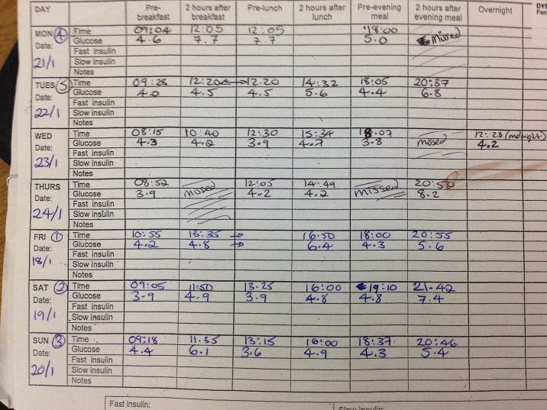
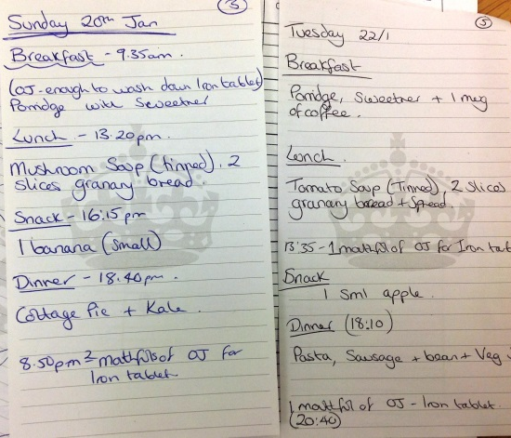

Slide 6
How can we deliver high quality care to many more women while reducing costs for both healthcare providers and women?

Slide 7
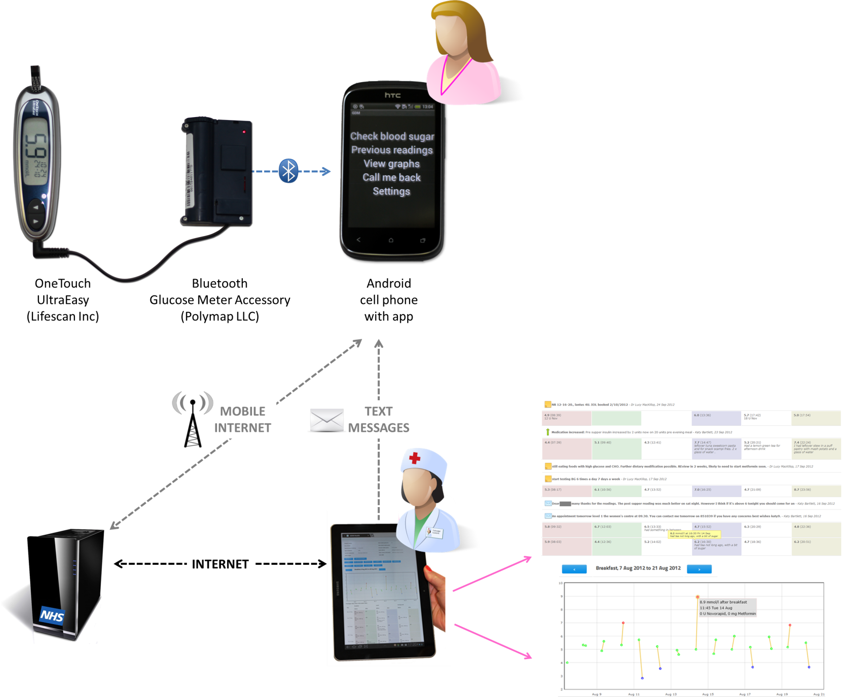
AJ Farmer et al (2005), Diabetes Care, vol. 28, 11, pp. 2697-2702
ME Larsen et al (2010), J Telemed Telecare, 16, pp.433-440
J Turner et al (2009), Inform Prim Care, 17, pp. 47-53
Notes:
The GDm-Health Management System was designed to allow women to monitor their BG using a glucose meter with a smartphone running a preloaded software application. Readings are automatically transferred from the glucose meter via Bluetooth to the phone and from the phone to an NHS server using the 3G network. The use of Bluetooth allows automatic real-time upload of BGs without the need for patients to enter the data manually, removing the possibility of error.

Slide 8
Healthcare professionals use the website to:
Review submitted data
Automatic prioritization of patients
Feedback via text messages
Notes:
The clinical team can access the BG readings from each patient through a purpose built website.
Pre set warnings can be programmed to warn the clinicians and prioritise patient care.
They can communicate with patients via text messages.

Slide 9
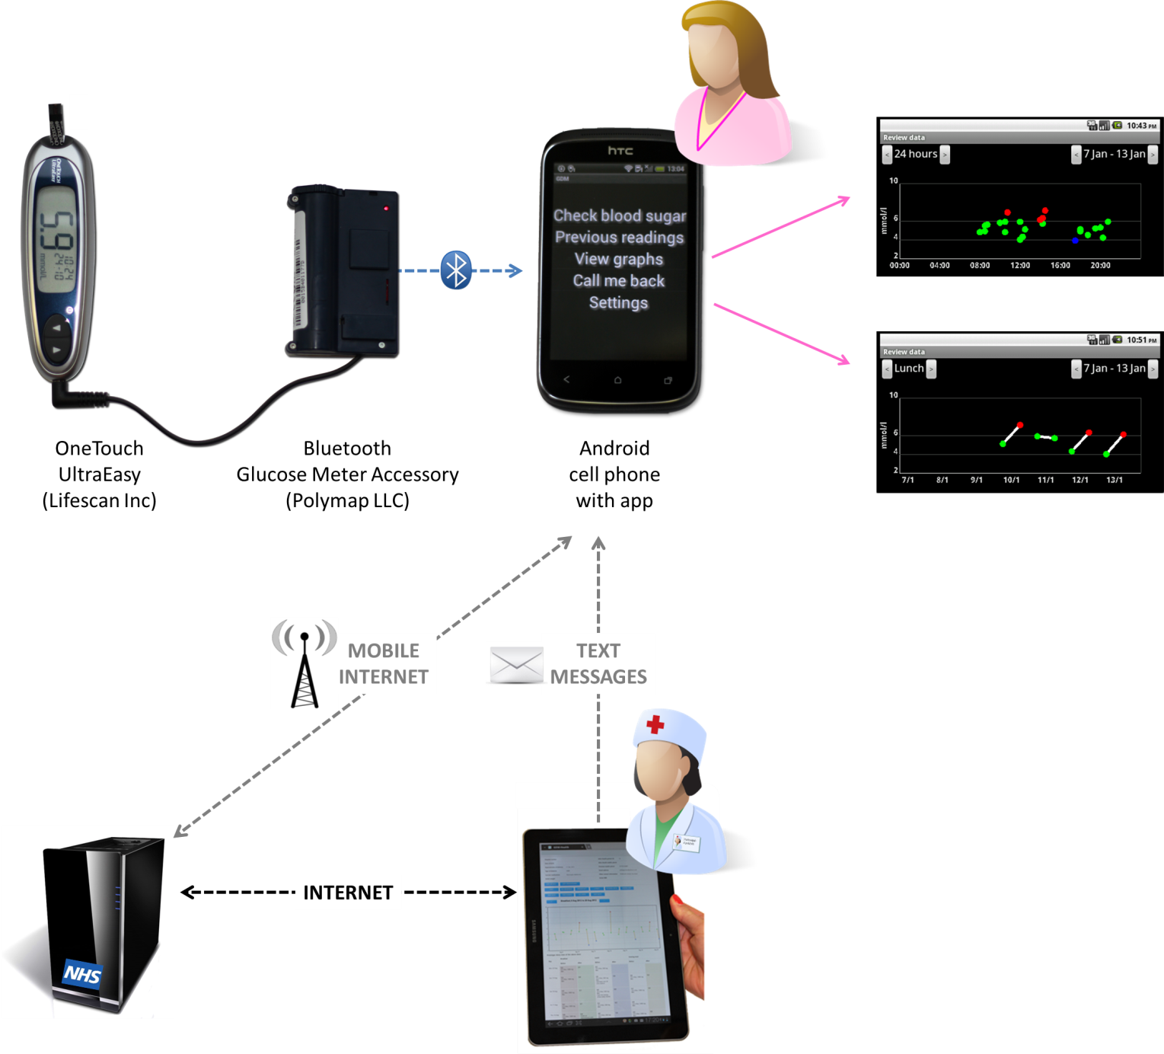
Patients use the phone app to:
Annotate SMBG data with meal tags, medication doses and other comments
Review previous data graphically
Request a call back from the midwife
Notes:
Patient interface- The patients use the phone app to tag their readings, document doses of medication and add comments e.g. high reading/naughty meal…………

Slide 10
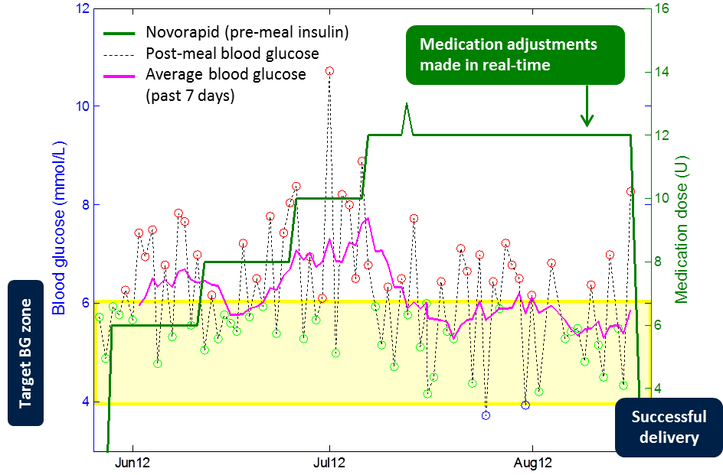
Real-time management (GDm-Health)

Slide 11
Benefits
Use of new technologies for the management of GDM
Tele-health system tested by patients
High patient and provider satisfaction
Advantages:
  Electronic transfer of data
  Real-time transmission
  Real-time feedback
  Prioritisation of patients who require extra support/intervention
  Facilitates team-based working
  BGs and other information recorded electronically – facilitates
  meaningful audit

Slide 12

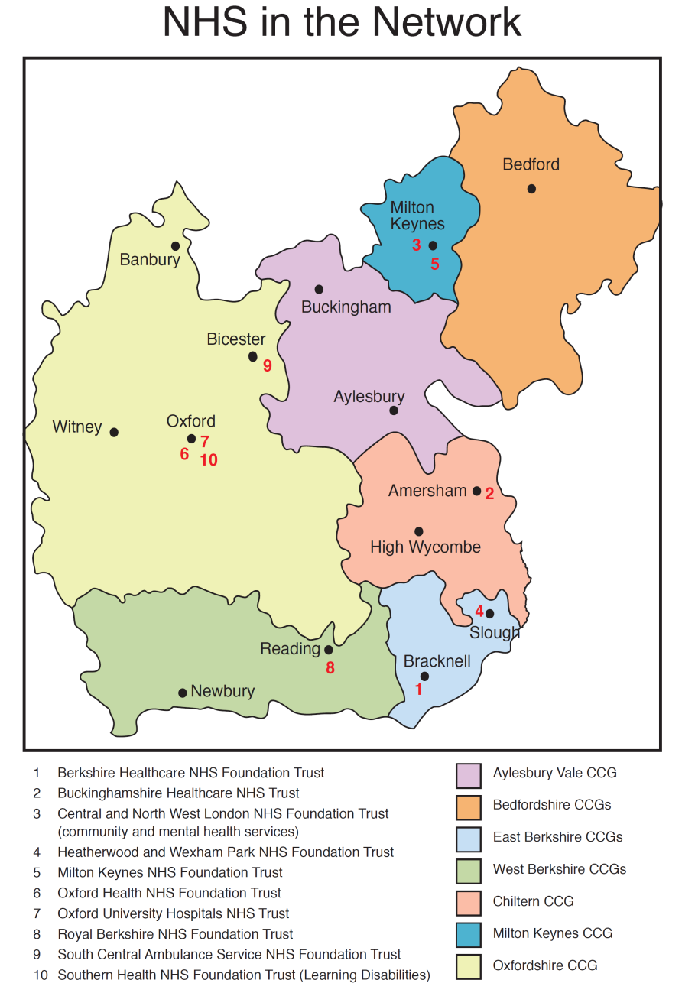

Slide 13
Clinical Innovation Adoption Programme
The key objective is to increase the speed of Clinical Innovation Adoption across the region by:
Assessing the strategic priorities and clinical needs of the population
Identifying best innovations that contribute to the resolution of the priorities
Redesigning clinical pathways with the objective to integrate innovations at all relevant points so as to increase quality of care and cost efficiency
Working closely with Wealth Creation to develop meaningful engagement with Industry and to deliver the above and to articulate the requirements
Embedding innovation adoption in local NHS planning and contracting so that projects provide maximum quality impact and cost savings.

Slide 14





Developing a New Product, Engaging the NHS
An Idea
Get the Idea Straight
Get into Position
Ready to Launch
Strike the Target
-Know your USP
-Check the clinical need
-Get clinicians on board
-Have a Business Plan
-Do initial Market research of interest
-Do a small Health Economic piece
-Understand the care pathway
-Research the competition
-Check feasibility
-Make contact with possible routes for assistance such as SBRI, Innovation Technology Fund, Innovation UK, other expert organisations and your local AHSNs
-Do impact studies in Clinical Setting to determine real benefits.
- Do a detailed Health Economics proposal to get into the detail.
-Always ask yourself are you providing a solution to a problem?
-Is the evidence fit for purpose?
-Get advice from your local AHSN
- Choose your Early Adopters wisely
is the innovation fitting in with the care pathway and is there a comprehensive Business Case for it?
- Best positioned to succeed!
An idea
Getting the idea straight
Getting into Position
- Make contact with possible routes for assistance such as SBRI, Innovation Technology Fund, Innovation UK, your local AHSNs
Strike the target
Ready to launch

Slide 15
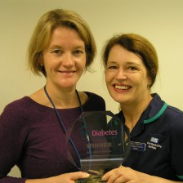


Adoption of GDm-health in clinical practice
2012 – 2015: Beta testing + service development (50 women, approximately 20,000 BG readings)
2013 – 2015: Randomised Controlled Trial in OUH NHS Trust (200 women)
Best Digital Initiative award for Quality in Care Diabetes 2014
Clinical Innovation Adoption in local region supported by Oxford AHSN
26% reduction in clinic visits for women using the GDm-health app
50% decrease in time spent by diabetes midwives on clerical and admin tasks

Slide 16
Why has the adoption of GDm-health been successful?
Committed Clinician | Providing clinician to clinician discussion Training Research | ✓
Patient involvement, engagement, experience incorporated | Patient involvement/experience was included from the start….. | ✓
Oxford Academic Health Science Network (AHSN) | Project management, commercial management | ✓
Institute of Biomedical Engineering | Prepared to come out to the Hospitals Available to provide technical support | ✓

Slide 17
Thank you for listening
Lucy Mackillop
Lucy.mackillop@ouh.nhs.uk
Oxford Academic Health Science Network
info@oxfordahsn.org

